Slide 1

Computer Networks
Week # 02
M.Nadeem Akhtar
CS & IT Department
The University of Lahore
Email: nadeem.akhtar@cs.uol.edu.pk
URL-https://sites.google.com/site/nadeemuolcsccn/home
Powerpoint Templates

Slide 2
Book 1 (Chapter 2): Network Models
Powerpoint Templates

Slide 3
Protocol Layering
Protocol layering allows us to divide a complex task into several smaller and simpler tasks
A layer (module) is a black box with inputs and outputs without concerns about the conversion of inputs to outputs
A layer needs to be able to receive a set of services from the lower layer and to give the services to the upper layer
We do not care about how the layer is implemented
There are also intermediate systems other than end-systems used by communication with respect to protocol layering in the Internet

Slide 4
Principles of Protocol layering
First principle
For bidirectional communication: Each layer should be able to perform two opposite tasks
3rd layer task is to talk (in one direction) and listen (in other direction)
2nd layer encrypt (on one side) and decrypt (other side)
1st layer, send and receive email

Slide 5
Principles of Protocol layering
Second principle
Two objects under each layer at both sides should be identical
Objects under layer 3 : plain text
Objects under layer 2: Cipher text
Objects under layer 1: a piece of mail

Slide 6
Models of Layers (Book1: 2.1)
Principals (Book1: 2.1.2)
Create a layer where a different abstraction is needed
Each layer should perform a well-defined function
The function of each layer should be chosen
With target for standardization
Minimize information flow across layer boundaries
Number of layers
Large: distinct functions are not in the same layer
Small : architecture does not become complex

Slide 7
INTERFACE BETWEEN LAYERS
The passing of the data and network information down through the layers of the sending device and back up through the layers of the receiving device is made possible by an interface between each pair of adjacent layers.
Each interface defines the information and services a layer must provide for the layer above it.
Well-defined interfaces and layer functions provide modularity to a network.

Slide 8
Reference Models
Layers model
A theoretical approach describing how data is going to be transmit over the network
1-The OSI Reference Model (minus physical medium)
2-The TCP/IP Protocol Suit: Used in all WANs, the ARPANET, worldwide Internet

Slide 9
1-OSI Reference Model (Book1: 2.3)
International Standard Organization (ISO) established in 1947 is a multinational body dedicated to worldwide agreement on international standards
An ISO standard that covers all aspects of network communication is the Open Systems Interconnection (OSI) model (first introduced in 1970)
The OSI model provides a conceptual understanding of LAN/WAN internetworking
ISO is the organization and OSI is the model

Slide 10
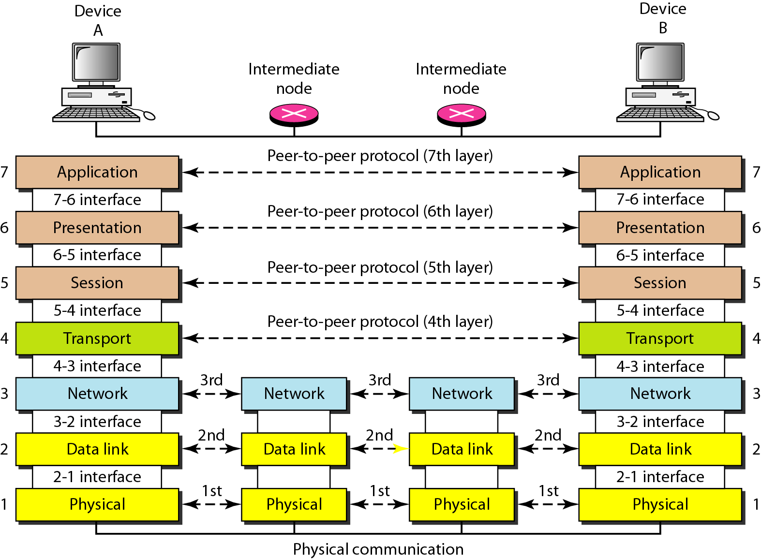
1-OSI Reference Model

Slide 11
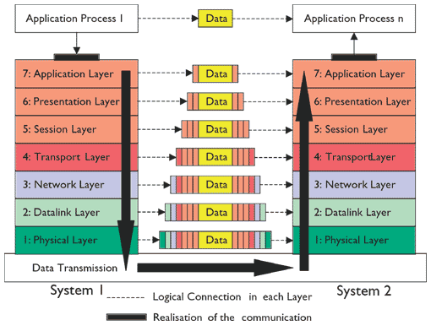

Slide 12
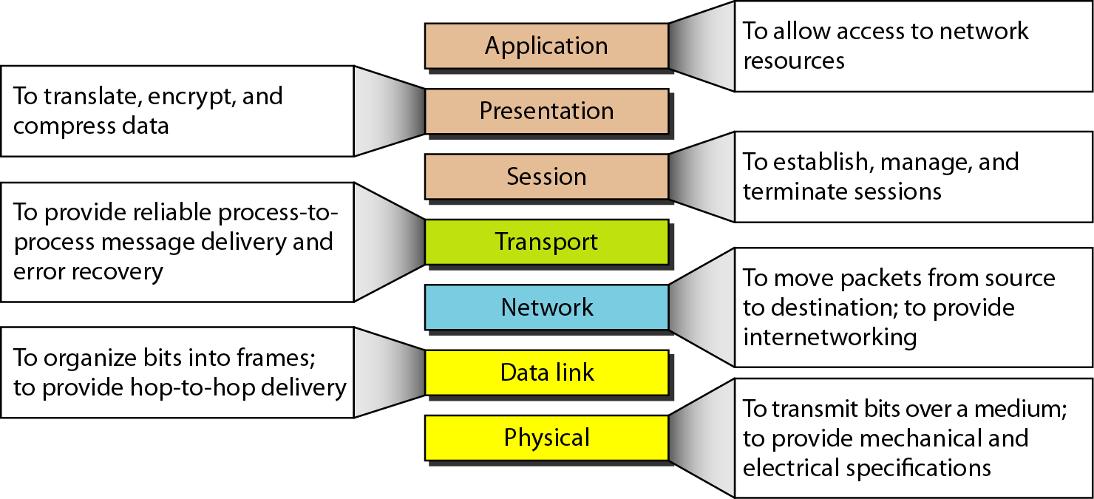
Summary of OSI layers

Slide 13
2-TCP/IP PROTOCOL SUITE (Book1: 2.2)
Transmission Control Protocol/Internet Protocol (TSP/IP) is a set of protocols organized in different layers used in the Internet today.
It is Hierarchical protocol: made up of interactive modules (each module provides specific functionality)
Hierarchical means that each upper level protocol is supported by the services provided by one or more lower level protocols.
The layers in the TCP/IP protocol suite do not exactly match those in the OSI model.

Slide 14
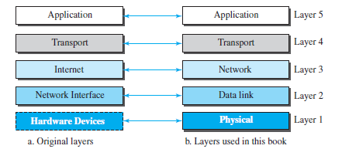
2-TCP/IP PROTOCOL SUITE
The original TCP/IP protocol suite was defined as having four layers: host-to-network, internet, transport, and application.
However, when TCP/IP is compared to OSI, we can say that the TCP/IP protocol suite is made of five layers: physical, data link, network, transport, and application.

Slide 15
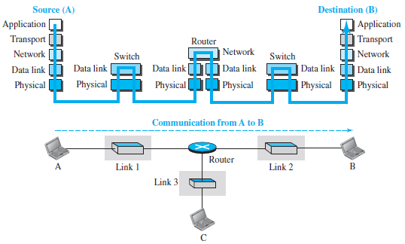
TCP/IP Layered Architecture (Book1:2.2.1)
Consider a small internet of three LANs (each with a link layer switch).
Further, assume that links are connected by one router

Slide 16
TCP/IP Layered Architecture
The two hosts are involved in all five layers
Source host creates a message in the application layer and sends it down the layer for physical delivery to the destination host
Destination host receives the communication at physical and then deliver to the application layer through other layers
Router is involved three layers
Involved in only one network layer; but involved in n (number of links) combinations of link and physical layers
Each link may use its own data link and physical protocol
Link layer switch is involved in only two layers
It is involved only in one data-link and one physical layer

Slide 17
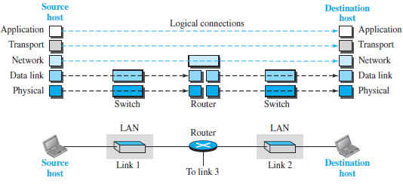
LAYERS IN THE TCP/IP Protocol Suit (Book1:2.2.2)
Logical connections make easier to think about the duty of each layer.
The duty of the application, transport, and network layers is end-to-end (so domain is internet).
However, the duty of the data-link and physical layers is hop-to-hop, a hop being a host or router (domain is link).

Slide 18
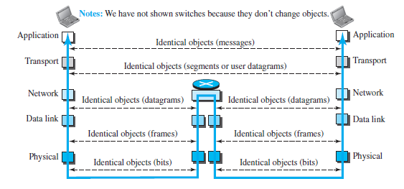
LAYERS IN THE TCP/IP Protocol Suit
Logical connections may be though of as data unit created at each layer, a hop being a host or router.
In top three layers
Data unit (packets) should not be changed by any router or link-layer switch.
In the bottom two layers,
the packet created by the host is changed only by the routers, not by the link-layer switches.

Slide 19
Description of TCP/IP Suit Layers
Book1: 2.2.3

Slide 20
1-PHYSICAL LAYER IN THE TCP/IP
responsible for carrying individual bits in a frame across the link.
Transmission medium does not carry bits; it carries electrical or optical signals.
So the bits received in a frame from the data-link layer are transformed and sent through the transmission media,
but we can think that the logical unit between two physical layers in two devices is a bit.
There are several protocols that transform a bit to a signal.

Slide 21
2-DATA-LINK LAYER IN THE TCP/IP (1)
Several overlapping sets of links for datagram to travel from source to the destination.
The routers are responsible for choosing the best links.
When the next link to travel is determined by the router,
the data-link layer takes datagram and moves across the link.
The link can be a wired LAN with a link-layer switch, a wireless LAN, a wired WAN, or a wireless WAN.
In each case, the data-link layer is responsible for moving the packet (frame) through the link.

Slide 22
2-DATA-LINK LAYER IN THE TCP/IP (2)
The data-link layer takes a datagram and encapsulates it in a packet called a frame.
Each link-layer protocol may provide a different service.
Some link-layer protocols provide complete error detection and correction,
some provide only error correction.

Slide 23
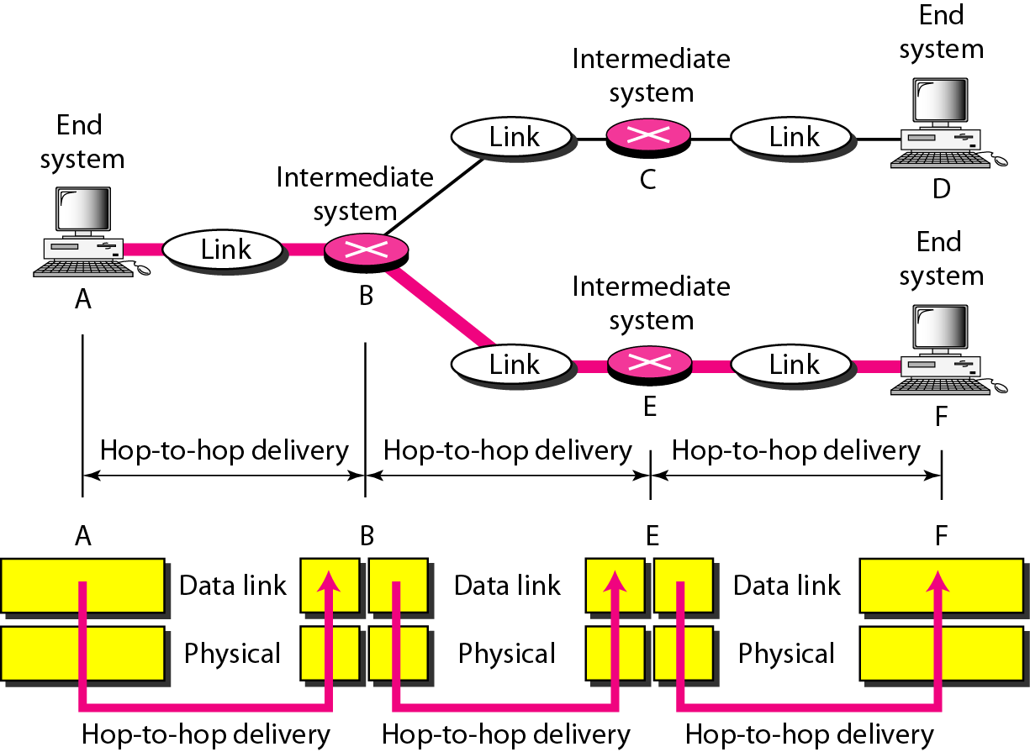
Hop-to-hop delivery

Slide 24
3-NETWORK LAYER IN THE TCP/IP (1)
Responsible for creating a connection between the source and the destination.
The communication at the network layer is host-to-host.
Routers in the path are responsible for choosing the best route for each packet.
So, network layer is responsible for host-to-host communication and routing the packet through possible routes.
In the Internet, it includes the main protocol, Internet Protocol (IP), that defines
the format of the packet, called a datagram at the network layer.
the format and the structure of addresses used in this layer.

Slide 25
3-NETWORK LAYER IN THE TCP/IP (3)
IP is also responsible for routing a packet from its source to its destination,
achieved by each router forwarding the datagram to the next router in its path.
It includes unicast and multicast routing protocols
Routing is duty of IP (not of routing protocol)
Routing protocol helps routers in routing process
By creating forward tables for routers

Slide 26
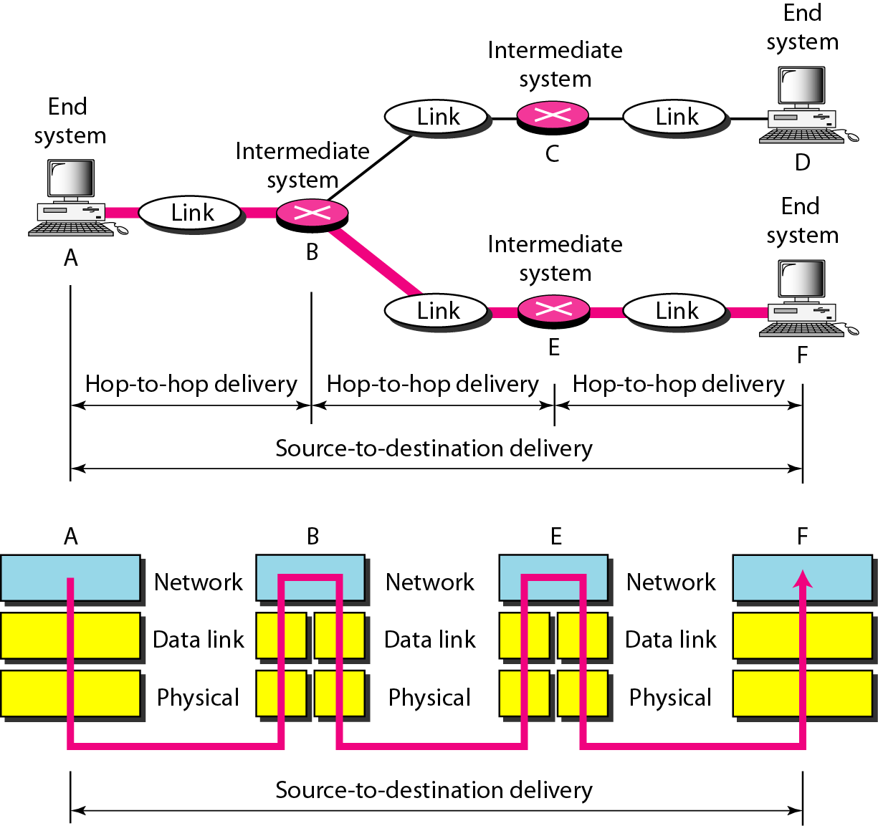
Source-to-destination delivery

Slide 27
4-TRANSPORT LAYER IN THE TCP/IP (1)
The logical connection at the transport layer is also end-to-end.
It encapsulates message from the application layer in a packet (called a segment or a user datagram) and
sends it, through the logical connection, to the transport layer at the destination host.
So transport layer is responsible for giving services to the application layer: to get a message from an application program running on the source host and deliver it to the corresponding application program on the destination host.
There are more than one protocol in the transport layer,
Thus, each application program can use the protocol that best matches its requirement.

Slide 28
4-TRANSPORT LAYER IN THE TCP/IP (2)
Transmission Control Protocol (TCP), is a connection-oriented protocol that first establishes a logical connection between transport layers at two hosts before transferring data.
Connection-oriented means a connection must be established between both ends of a transmission before either can transmit data.
Provides flow control, error control, congestion control
User Datagram Protocol (UDP), is a connectionless protocol that transmits user datagrams without first creating a logical connection.
Connectionless means each user datagram is independent without being related to previous or next one
Stream Control Transmission Protocol (SCTP) is designed to respond to new applications that are emerging in the multimedia.

Slide 29
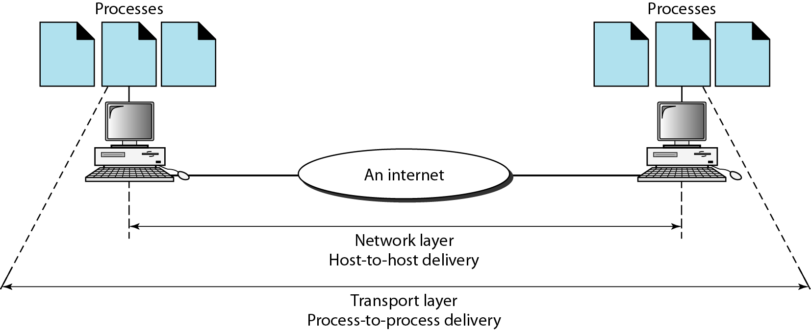
Reliable process-to-process
delivery of a message

Slide 30
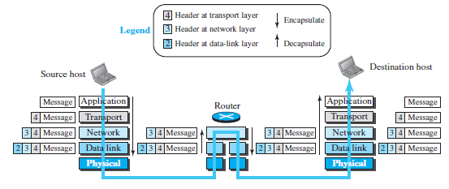
Encapsulation and Decapsulation (Book1: 2.2.4)
Encapsulation at the Source Host
Decapsulation and Encapsulation at the router
Decapsulation at the Destination Host
Message -----segment/user datagram --- datagram --- frame
Transmission Control Protocol

Slide 31
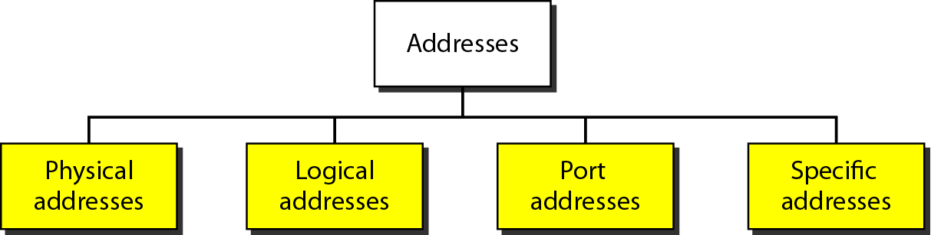
TCP/IP Suit ADDRESSING (Book2: 2.2.5)
Any communication that involves two parties needs two addresses: source address and destination address
Four levels of addresses are used in an internet employing the TCP/IP protocols: physical, logical, port, and specific.
No address required at physical layer as the unit of data exchange is a bit which definitely cannot have any address
There is a relationship between the layer, the address used in that layer, and the packet name at that layer.

Slide 32
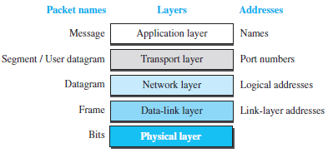
ADDRESSING
There is a relationship between the layer, the address used in that layer, and the packet name at that layer.

Slide 33
1-SPECIFIC ADDRESSING
Specific Address:
Some applications have user-friendly addresses that are designed for that specific address.
At the application layer, we normally use names (Specific address) to define the site that provides services, such as someorg.com, or the e-mail address, such as somebody@coldmail.com.
These addresses, however, get changed to the corresponding port and logical addresses by the sending computer.

Slide 34
2-TRANSPORT LAYER ADDRESSING
Transport layers addresses are called port numbers, and
Port numbers are local addresses that distinguish between several programs running at the same time.
Each application runs with a port no.(logically) on the computer.
This port no. for application is decided by the Kernel of the OS.
This port no. is called port address (address at transport layer).
A port address is a 16-bit address represented by one single decimal number like 753

Slide 35
3-LOGICAL ADDRESSING
At the network-layer, the addresses are global, with the whole Internet as the scope.
A network-layer address uniquely defines the connection of a device to the Internet
Logical addresses are necessary for universal communications that are independent of underlying physical networks
Physical addresses are not adequate in an internetwork environment where different networks can have different address formats.

Slide 36
3-LOGICAL ADDRESSING
A universal addressing system is needed
in which each host can be identified uniquely, regardless of the underlying physical network.
The logical addresses are designed for this purpose.
A logical address in the Internet is currently a 32-bit address (IPv4) that can uniquely define a host connected to the Internet.

Slide 37
4-PHYSICAL ADDRESSING
Physical Address (also known as the link address /MAC address)
is the address of a node as defined by its LAN or WAN
is included in the frame used by the data link layer
is the lowest-level address
The size and format of these addresses vary depending on the network.
For example, Ethernet uses a 6-byte (48-bit) physical address that is imprinted on the network interface card (NIC)
written as 12 hexadecimal digits;
every byte (2 hexadecimal digits) is separated by a colon: 07:01:02:01:2C:4B

Slide 38
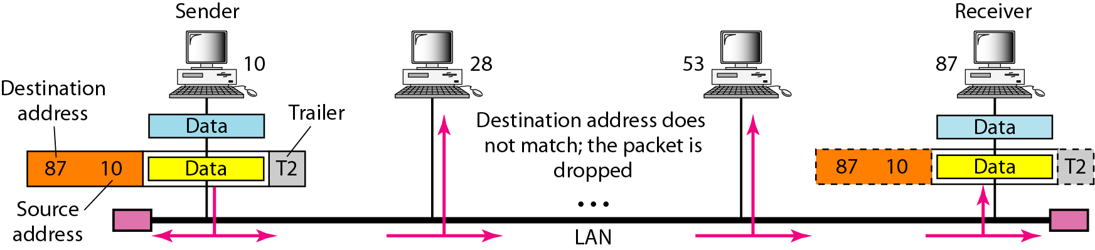
Example 1
a node with physical address 10 sends a frame to a node with physical address 87. The two nodes are connected by a link (bus topology LAN). As the figure shows, the computer with physical address 10 is the sender, and the computer with physical address 87 is the receiver.

Slide 39
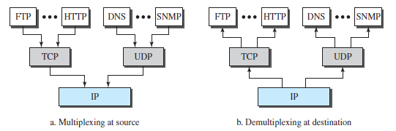
Multiplexing and De-multiplexing (Book2:2.2.6)
Multiplexing means that a protocol at a layer can encapsulate a packet from several next-higher layer protocols (one at a time);
De-multiplexing means that a protocol can de-capsulate and
deliver a packet to several next-higher layer protocols

